Slide 1
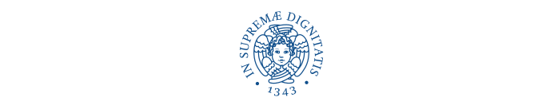
Learning Spatio-Temporal Representation with Pseudo-3D Residual Networks
Dawit Anelay
d.anelay1@studenti.unipi.it
Intelligent Systems for Pattern Recognition

Slide 2
Introduction to the problem
300 hours of video are uploaded to YouTube every minute!
⚫ CNN • For Image Processing problem . It’s has been a powerful approach model.
• For Learning Spatio-Temporal Representation ? For Video Processing,? E.g For Human Action detection ?.
⚫ A Rewarded Study Approche • Performing 3D Convolutions (Encourage Performance on Sport-1M dataset 85.2%).
• Model : C3D,ResNet-152 .
⚫ Problem • Computational Cost and Memory Demand . ( Model C3D--321MB with 11-layer, ResNet-152--235MB with 152-layer).
• Model Size has Quadratic Growth Compare to 2D CNN AND Very Difficult to Train Because they are very deep.
⚫ Proposed Idea • Why not recycle off-the-shelf 2D networks for a 3D CNN.
⚫ Solution • De-Couple 3D CNN =2D CNN (Spatio-Domain) + 1D CNN (Temporal -Domain).
• A New Architecture Named P3DResNet with a new designed Block model that simulate 3D CNN in an Economic and efficient way.

Slide 3
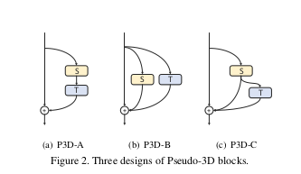
P3D Blocks and P3D ResNet
(2) P3D-B: There is no direct influence between S and T, both of them are directly accumulated into the final output
(I + S + T) · x t := x t + S (x t ) + T (x t ) = x t+1 .
(3) P3D-C:A compromise between P3D-A and P3D-B, by simultaneously building the direct influences among S, T and the final output.
(I + S + T) · x t := x t + S (x t ) + T (x t ) = x t+1 .
⚫ Design issue while decoupling 3D CNN.
① The first issue is about whether the modules of 2D filters on spatial dimension (S) and 1D filters on temporal domain (T) should directly or indirectly influence each other.
‣Directly - cascaded manner ‣ Indirectly-parallel fashion.
② The second issue is whether the two kinds of filters should both directly influence the final output.
(1) P3D-A:The two kinds of filters can directly influence each other in the same path and only the temporal 1D filters are directly connected to the final output,
(I + T · S) · x t := x t + T (S (x t )) = x t+1 .

Slide 4
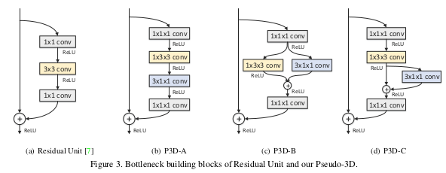

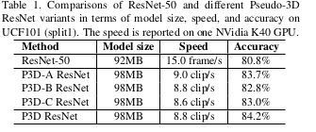
Bottleneck architectures.
Table 1. Comparisons of ResNet-50 and different Pseudo-3DResNet variants in terms of model size, speed, and accuracy on UCF101. The speed is reported on one NVidia K40 GPU.
• Three P3D ResNet variants, i.e., P3D-AResNet, P3D-B ResNet and P3D-C ResNet by replacing all the Residual Units in a 50-layer ResNet (ResNet-50) with one certain kind of P3D block, respectively.
• A complete version of P3D ResNet is proposed by mixing all the three P3D blocks from the viewpoint of structural diversity.Residual Units with a chain of
Figure 4. P3D ResNet by interleaving P3D-A, P3D-B and P3D-C.
P3D blocks in the order P3D-A→P3D-B→P3D-C.
• No explicit reason stated why this type of order.
• The speed of the model is very fast and could reach 9 clips per second.

Slide 5
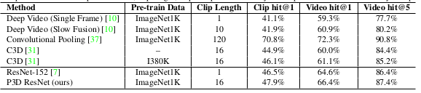
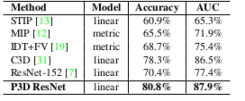
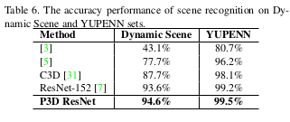
Spatio-Temporal Representation Learning-Result
The learning conducted on Sports-1M dataset(1.13 million videos annotated with 487 Sports labels).
P3D ResNet leads to a performance boost against ResNet-152 (2D CNN) and C3D (3D CNN)by 1.8% and 5.3% in terms of top-1 video-level accuracy,respectively.
⚫ Video Representation Evaluation on three different tasks and five popular datasets
① action recognition - UCF101 and ActivityNet dataset
②action similarity - does a pair of videos present the same action?”-ASLAN
③ scene recognition on Dynamic Scene and YUPENN sets.
In all task the model Leads to a performance boost
Table 2. Comparisons in terms of pre-train data, clip length, Top-1 clip-level accuracy and Top-1&5 video-level accuracy on Sports-1M.
Table 5. Action similarity labeling performances on ASLAN benchmark. STIP.STIP: Space-Time Interest Points; MIP: Motion Interchange Patterns; FV: Fisher Vector.

Slide 6
Conclusion
⚫ Strong points
① P3D ResNet is an effect way for For Learning Spatio-Temporal Representation .
② Performance improvements are clearly observed when comparing to other feature learning techniques.
⚫ weaknesses
① The speed of the model is consider only with a small video frame size (16 frame -long).
⚫ Futurework
① Attention mechanism
② Extend P3D ResNet learning to other types of inputs, e.g., optical flow or audio.

